Slide 1

Python for QA
Python Basics. Part 1.

Slide 2
Build-in Types
None
bool: True, False
int: 5, 12334, -32
float: 11.01, -102.3456
str: 'hello world, "python for qa", '''very long string''', """one more string"""
tuple: (1, 2, 3, 4)
list: [1, 2, ‘a’, False]
set: {1, 5, 6 ,8}
dict: {‘first_name’: ‘John’, ‘last_name’: ‘Smith’}
file
Notes:
numeric + long and complex

Slide 3
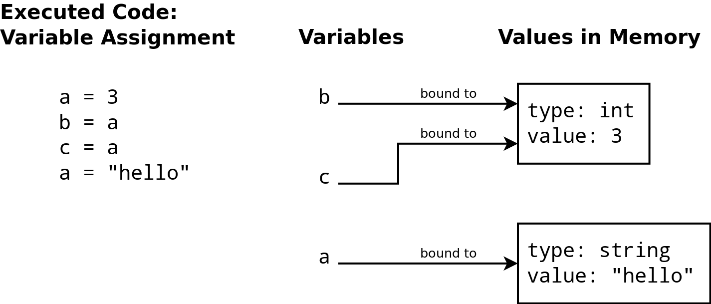
Variables
Notes:
dynamic, duck typing, strong typing
id, =,
source: http://swcarpentry.github.io/training-course/2013/05/python-variables-a-diagram-that-is-not-a-concept-map/

Slide 4
Operators
Logical: or, and, not
Arithmetic: -, +, *, /, //, %, **
Assignment: =, +=, -=, *=, /=
Comparison: >, <, >=, >=, ==, !=
Membership: in, not in
Identity: is, not is
Precedence and round brackets ‘()’
Notes:
=
or and not
-, +, *, \, \\, %, **
>, <, >=, >=, ==, !=, is
()
http://www.tutorialspoint.com/python/python_basic_operators.htm
https://docs.python.org/2/library/operator.html

Slide 5
Data Type Conversion
int(): str, float → int
float(): str, int → float
str(): integer, float, list, tuple, dictionary → string
list(): string, tuple, dictionary → list
tuple(): string, list → tuple
set(): string, list → set

Slide 6
Truth Value Testing
False values:
None
False
zero of any numeric type
empty sequence
empty mapping type
True values:
all other objects
Notes:
id
type, isinstanceof

Slide 7
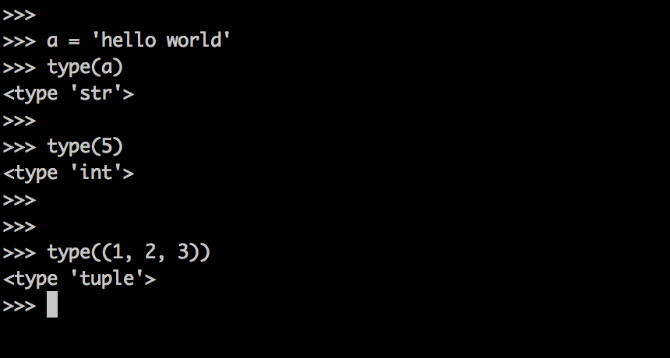
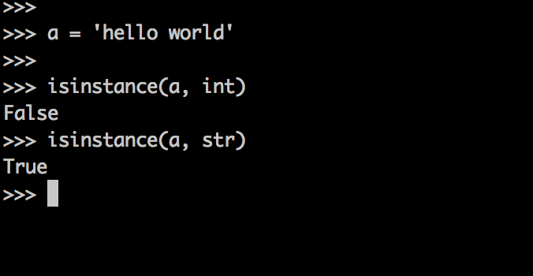
Type Detection
type()
isinstanceof()
Notes:
id
type, isinstanceof

Slide 8
Practice
None
bool
numbers
different types of strings
sequences
tuple with one element
dict
in, not in, is, is not
id()
type() and isinstance()
Notes:
show None
show boolean
numbers example
show different types of strings + if quotes in string \
tuple with one elements
list
set
dict
file
type
isinstance

Slide 9
Data Types Methods and Operations

Slide 10
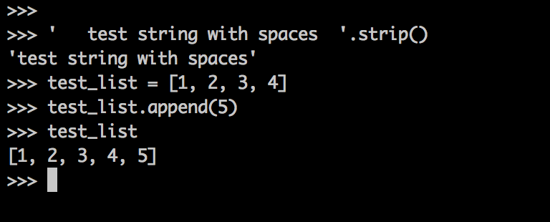
What is method?
In object-oriented programming, a method is a programmed procedure that is defined as part of a class and included in any object of that class.

Slide 11
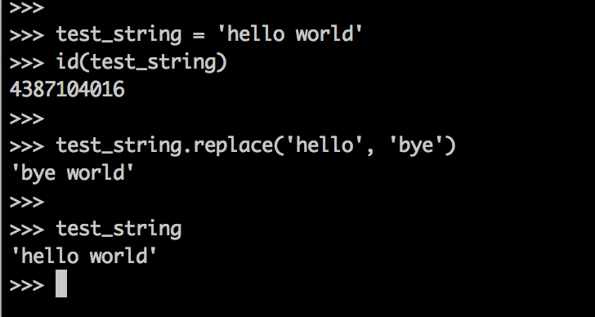
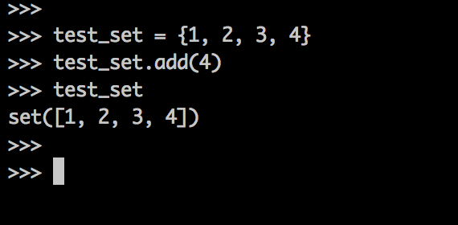
Immutable and Mutable
Immutable:
int
float
string
tuple
Mutable:
list
dict
set

Slide 12
Sequences Methods and Operations
All:
s[i]
s[i:j]
s[i:j:k]
len(s)
min(s)
max(s)
in
not in
s.index(x)
s.count(x)
Mutable:
s[i] = x
del s[i:j]
s.append(x)
s.extend(x)
s.index(x)
s.insert(i, x)
Notes:
len
in
s[i:]
tuple unpacking
https://docs.python.org/2/library/stdtypes.html
Index start with 0

Slide 13
String Methods
s.format() 'Hi {}'.format('John') → 'Hi John'
s.join() ' ,' .join(['alex', 'bill', 'david']) → 'alex, bill, david'
s.replace() 'Java is cool'.replace('Java', 'Python') → 'Python is cool'
s.split() 'alex, bill, david'.split(', ') → ['alex', 'bill', 'david']
s.strip() ' spaces in string '.strip() → 'spaces in string'
s.upper() 'Bruce Wayne'.upper() → 'BRUCE WAYNE'
s.lower() 'Bruce Wayne'.lower() → 'bruce wayne'
s.startswith() 'Bruce Wayne'.startswith('Br') → True
s.endswith() 'Bruce Wayne'.endswith('Br') → False

Slide 14
Mapping Types Methods
d[key]
d[key] = value
del d[key]
d.get(key, default_value)
d.items()
d.keys()
d.values()
d.update()
d.clear()
d.copy()

Slide 15
Practice
List
slices
get last element
reverse
get every second
is element in list
get element index
add element
remove element
extend vs append
String
format
join
replace
strip
split
upper
lower
get substring
lower
upper
Dict
get
in
keys
values
update
del
items
clear
copy
Notes:
start with immutable and mutable - show with id funciton
show make

Slide 16
Summary

Slide 17
Keywords
int
float
str
tuple
list
dict
set
None
range
len
index
min
max

Slide 18
Useful
Build-in Types
Basic Operators

Slide 19
Homework
Solve nexts tasks.
Level 1 - 1 point
Level 2 - 2 points
Level 3 - 4 points
Please create task*.py file for each problem solution in directory lesson2-1, where * is task number.

Slide 20
Questions?

